Slide 1
P5.2 Demo: Exploration of the Effect of Task and User Role on the Evaluation of Interpretability Techniques
Annual Fall Meeting, New York, September 2018
Notes:
Welcome

Slide 2

P5.2 Demo: Exploration of the Effect of Task and User Role on the Evaluation of Interpretability Techniques
Credit: U.S. Army/Sgt. Edwin Bridges)
Need:
Tool for comparing and showcase interpretability techniques.
Open-source framework offering data generation across an evolving set of datasets, models and explanation techniques.
Capability:
For Developers – An API framework allowing for development of research data
generation pipeline.
For subject matter experts – access to the current available ML explanation techniques.
For DAIS research colleagues - opportunities to collaborate!
Takeaways:
Open-Sourced at: github.com/dais-ita/interpretability_framework
Notes:
“I’ll start with some background about the work we’ve been doing in Project 5.2”
On the back of research from IPP6 we’ve been continuing our look at coalition situational understanding.
Within CSU, we outlined 5 aspects that were important , one of which was the interpretability of the decision support being provided by CSU systems.
In BPP5.2 we have focused on assessing the state of the art of interpretability with the aim to develop a formal metric for analyzing techniques. We also hope to discover novel, useable approaches to interpretability.

Slide 3
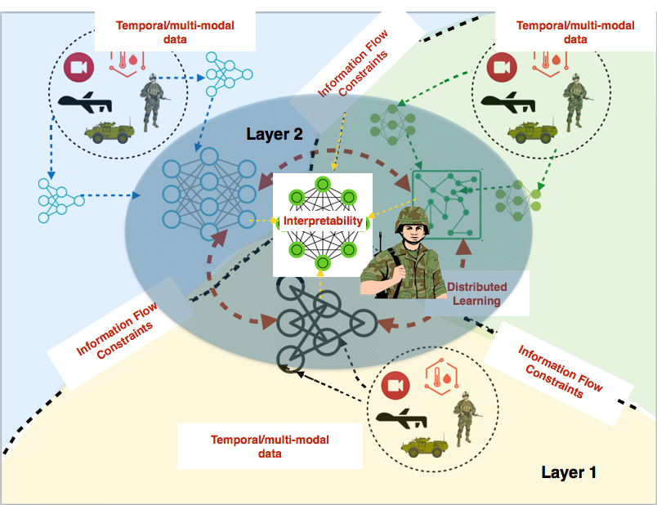
Motivation – Coalition Situational Understanding (CSU)
Credit: U.S. Army/Sgt. Edwin Bridges)
In IPP P6, we established 5 key features of CSU.
In BPP P5.2, interpretability of decision support models has been our focus.
Notes:
“I’ll start with some background about the work we’ve been doing in Project 5.2”
On the back of research from IPP6 we’ve been continuing our look at coalition situational understanding.
Within CSU, we outlined 5 aspects that were important , one of which was the interpretability of the decision support being provided by CSU systems.
In BPP5.2 we have focused on assessing the state of the art of interpretability with the aim to develop a formal metric for analyzing techniques. We also hope to discover novel, useable approaches to interpretability.

Slide 4
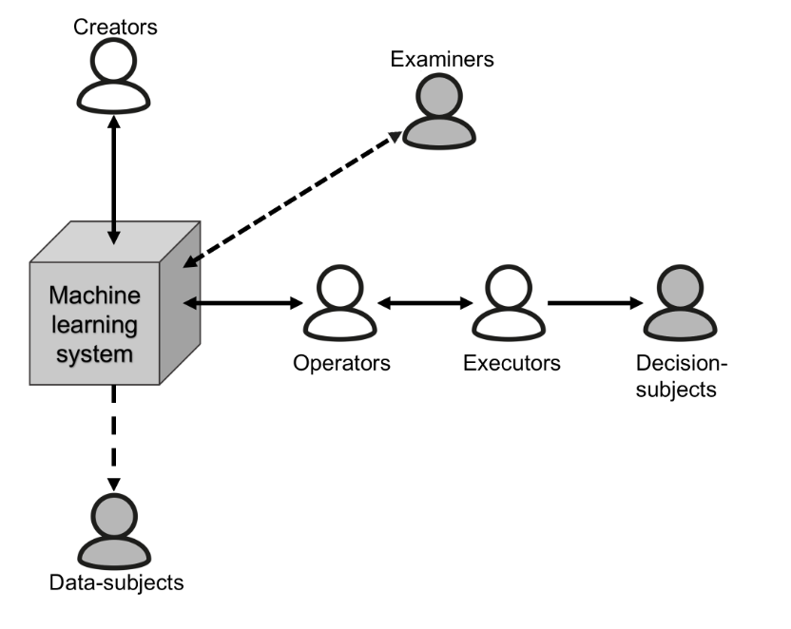
An agent’s role/relationship with a machine learning decision will effect the utility of interpretability techniques.
Coalition Engineer
Mission Commander
Analyst
Tomsett et al. “Interpretable to whom? A role-based model for analyzing interpretable machine learning systems” Presented at WHI 2018 at IC ML
User Knowledge may effect the details that can be provided within explanations.
Task of the agent may effect what information is useable.
Notes:
A recent and important proposition we’ve put forward is that the utility of different interpretability techniques is dependant on the role an agent has with relation to the decision support output.
To outline this, we’ve developed a framework outlining 6 user roles and we presented this in the paper ”interpretable to whom?”
Scenario 6: go no-go order in a military operation
Consider a scenario involving a military operation to kill
or capture a target. A machine learning system may be em-
ployed to find and help recognize this target, and the order
to engage will be informed based on the system’s recog-
nition. After the event, this order may be scrutinized at a
tribunal. This scenario includes the target, front-line per-
sonnel, analysts, a mission commander, tribunal jurors, and
a machine learning system that may be distributed across
several coalition partners.
– Creators: employees of the various coalition partners’ mili-
taries, employees of any military contractors involved
– Operators: military analysts
– Executor: the mission commander
– Decision-subject: the target, or agent identified as the target
– Data-subjects: other individuals of interest, their known
associates
– Examiners: tribunal jurors
To explore this, and other aspects of interpretability, we have developed an interpretability framework.

Slide 5
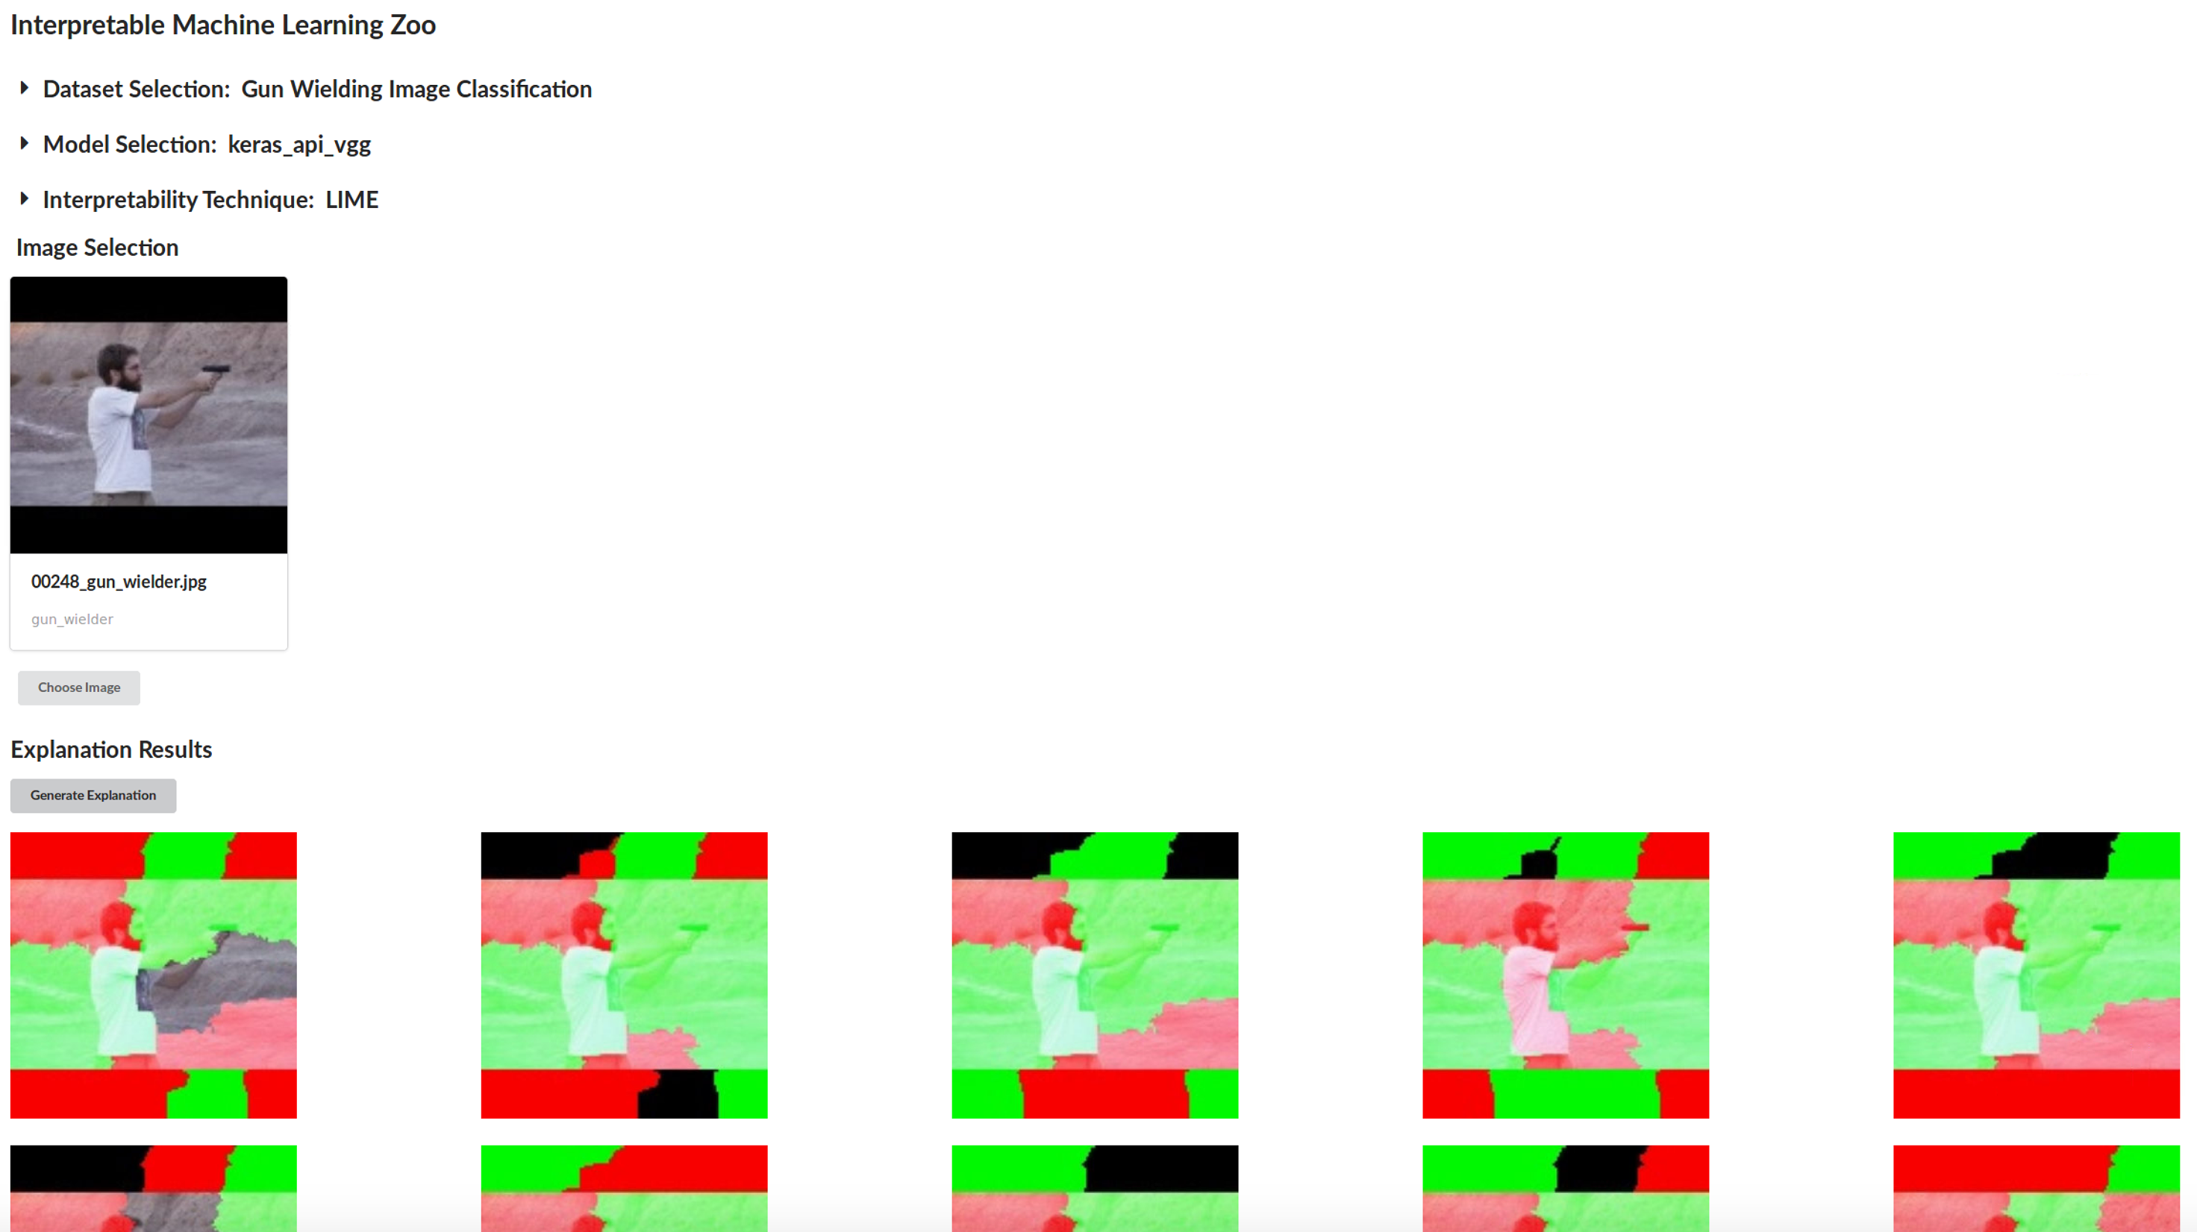
This demo showcases a framework that brings:
Easy Comparison of existing (and new) interpretability techniques.
Generating Data for experiments both analytical and human based testing.
Sharable Tool that through open-sourcing can help engage the wider Machine Learning community.
Notes:
The framework
bringing together datasets, models and explanation techniques
Easy comparison
Generate data for both analytics and for use in focus groups or trials with human participants.
Opensourced and easily shareable tool that can be made use of in the wider DAIS and Machine Learning community.

Slide 6
Experimentation Framework - Datasets, Models and Explanations
Datasets
Gun Wielder Classification
Traffic Congestion
CIFAR-10
MNIST
ImageNet
Models
Neural Networks:
VGG16
VGG19
InceptionV3
Inception ResNet V2
MobileNet
Xception
Other Models:
Support Vector Machine
Explanation Techniques
LIME
Shapley
Deep Taylor LRP
Influence Functions
Notes:
Current items in the framework
A range of items we’ve used in previous research as well as a range of popular datasets used for benchmarking and model architectures that have been shown to perform well against different benchmarks and in competitions as well as in practical applications.
The interpretability techniques are one receiving a lot of attention within the ML community.
This list is just the items we have currently, a bit later in the demo we’ll show the architecture behind the framework and discuss the ease at which items can be added.

Slide 7
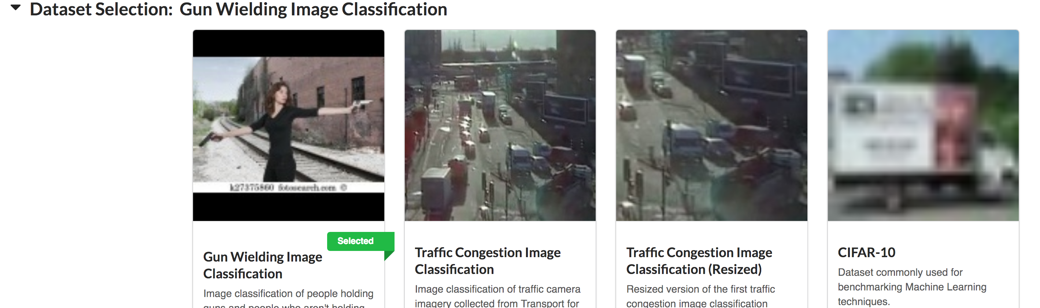
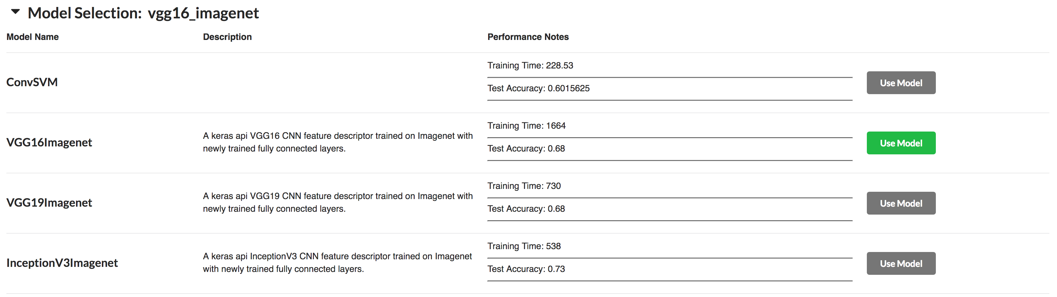
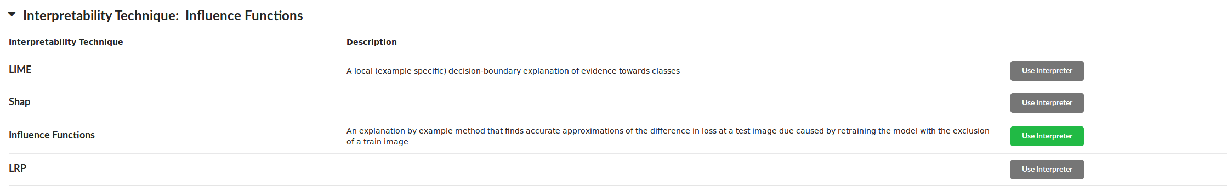
Experimentation Framework - Datasets, Models and Explanations
Notes:
Here is the framework interface we’re using currently.
It has a section for datasets
…
Models
…
Explanations
…
It’s worth noting for now that this interface is decoupled from the code that manages the execution and use of the items within the framework. This means that although this interface has been designed to be useful for us as researchers exploring these different items. You’re not locked in to using this format and I’ll discuss this in a few slides time.
We’ll now show a few use cases that this interface provides.

Slide 8
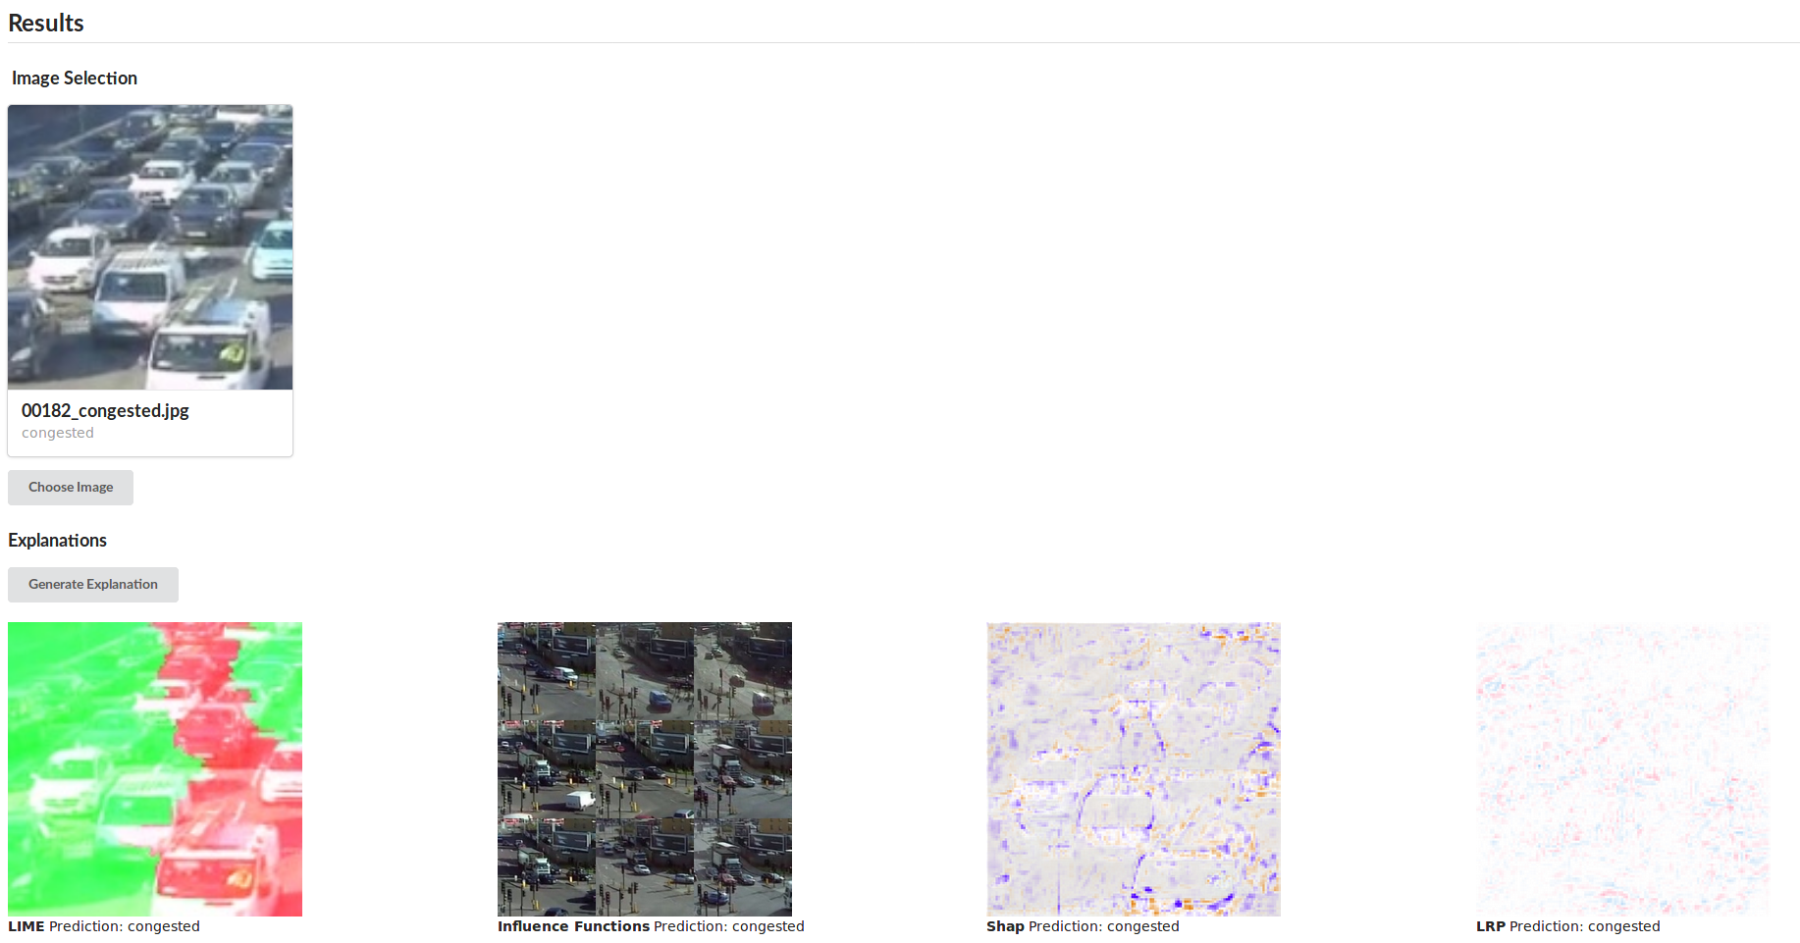
Use Case 1 – Multiple Explanation Techniques on the Same Input:
Experimentation Framework – Use Cases
Build Intuition for different techniques.
Compare Utility of different techniques – do different users (with different roles/knowledge) prefer different techniques.
Notes:
Use Cases
One model, multiple techniques , compare the outputs. In the context of looking for metrics or looking for viable decision support techniques,
Researchers can quickly use it to generate data to show to subject matter experts.
It’s also available and easy to use so SMEs or non-ML-trained researchers can use it and build their own intuitions or conduct research

Slide 9
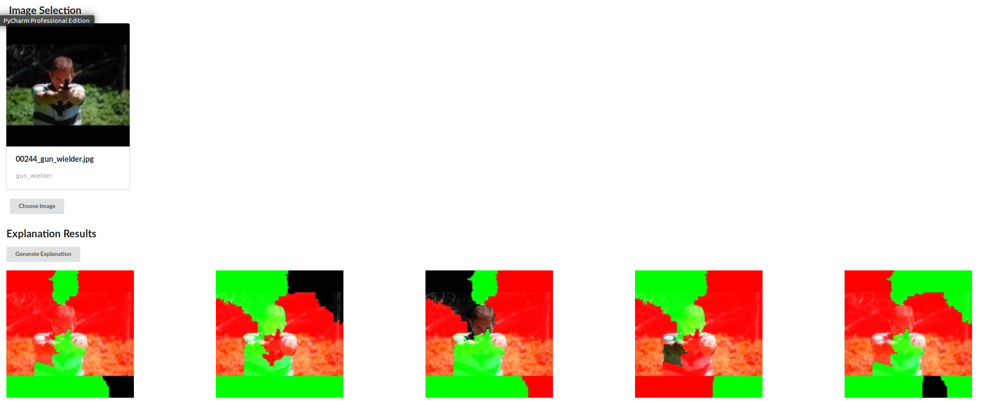
Use Case 2 – Multiple Explanations from the Same Technique:
Experimentation Framework – Use Cases
Build Intuition for how stable the technique is.
Generating Data for experiments.
Refine techniques as seen in collaborative work with West Point cadets.
Notes:
One model multiple explanations from same technique, spots instability
West Point cadet work
Non ML trained but know python

Slide 10
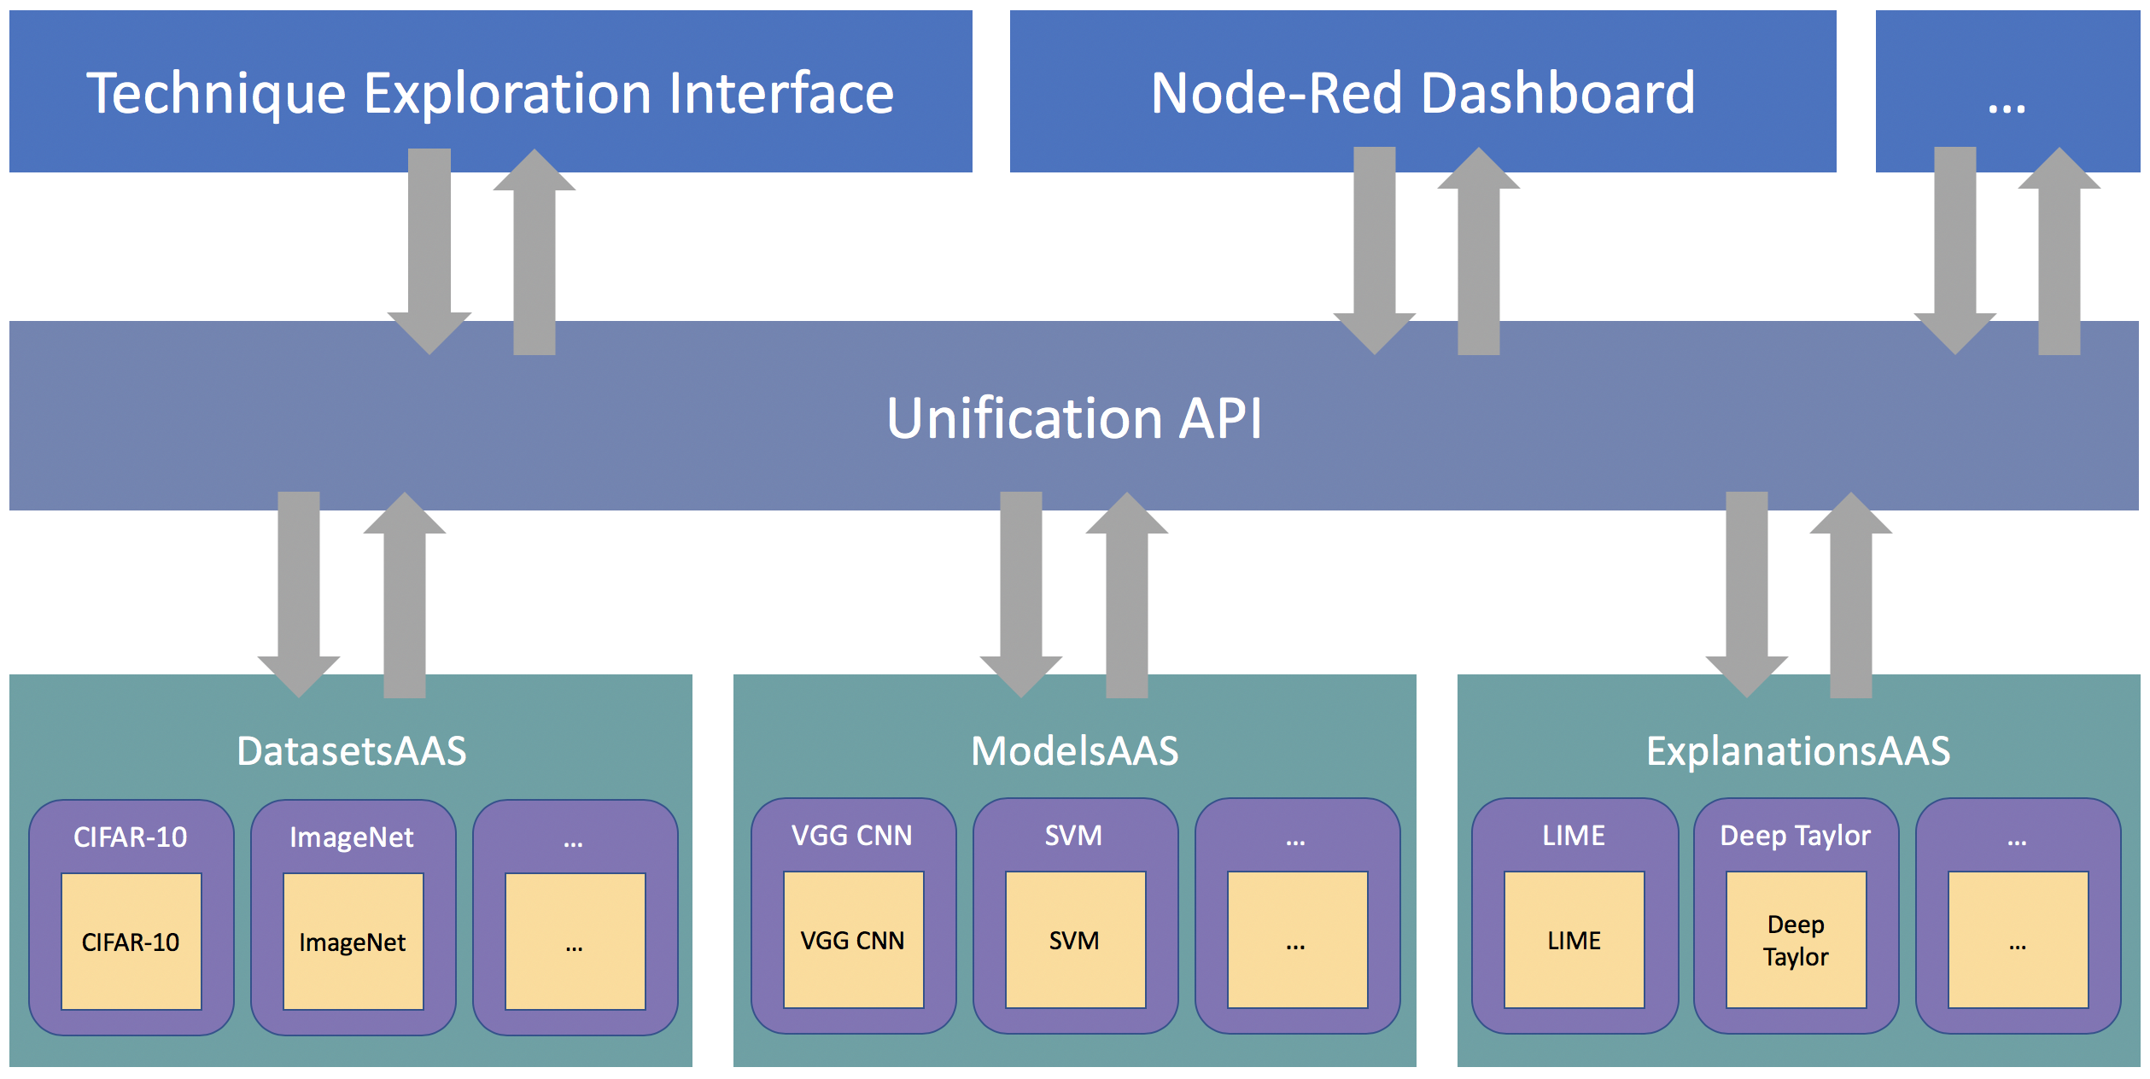
Experimentation Framework - Architecture
Notes:
Architecture and Design
3 decoupled layers
Wrapper class give uniform I/O to datasets , models and explanations
Flask services make these queryable and handle the dataflow and execution
A unified API gives a easy request based way to access the items in the frame work
The API allows for the final layer consisting of a user interface to be built decoupled from the framework allowing for different interface types to be built and customised to meet the needs of the researchers or the study
Those two use cases are particularly relevant to that specific interface. As mentioned previously, the interface is decoupled from the lower layers of the framework. This means if you have a specific requirement, perhaps you need to present data in a specific way to perform focus groups with subject matter experts, perform trials with human participants or present the interface in a different medium such as via a conversational interface, it’s very eay to make use of the API seen in the middle layer of this diagram, and build an interface.
I mentioned before it would be easy to add new items in……

Slide 11
P5.2 Demo: Exploration of the Effect of Task and User Role on the Evaluation of Interpretability Techniques
Credit: U.S. Army/Sgt. Edwin Bridges)
Need:
Tool for comparing and showcase interpretability techniques.
Open-source framework offering data generation across an evolving set of datasets, models and explanation techniques.
Capability:
For Developers – An API framework allowing for development of research data
generation pipeline.
For subject matter experts – access to the current available ML explanation techniques.
For DAIS research colleagues - opportunities to collaborate!
Takeaways:
Open-Sourced at: github.com/dais-ita/interpretability_framework
Notes:
“I’ll start with some background about the work we’ve been doing in Project 5.2”
On the back of research from IPP6 we’ve been continuing our look at coalition situational understanding.
Within CSU, we outlined 5 aspects that were important , one of which was the interpretability of the decision support being provided by CSU systems.
In BPP5.2 we have focused on assessing the state of the art of interpretability with the aim to develop a formal metric for analyzing techniques. We also hope to discover novel, useable approaches to interpretability.

